Slide 1
A Short Course on Macro-Fiscal Climate Economics
Providing a common framework to understand the intersection of macro-fiscal policy and climate change.

Slide 2
Table of Contents
Background
Net Zero
  IEA Roadmap
Fiscal Costs and Risks
  UK Fiscal Risks Report
Economics of Adaptation
  Shaping Climate Resilient Development
  Adaptation Gap Report
Common Framework

Slide 3
What training already exists?
What?
  ‘IMF Macroeconomics of Climate Change’
Where?
  On edX platform.
Goal:
  Provide a common framework to understand issues at the intersection of macroeconomics and climate change.
  Teach the key components of financial and monetary policies that can help manage physical and transition climate risks.
Expected Duration:
  3 weeks.
Target Audience:
  Mid-level to senior officials from central banks, ministries of finance, and other government agencies tasked with the design and execution of policies related to macroeconomics and climate change issues
Structure:
Science, Economics and Policies
Transition to Net Zero
Climate Risks for the Financial Sector
Green Public Finance
Mitigation Strategies
Economics of Adaptation

Slide 4
What can we offer?
What?
  ‘Macro-Fiscal Policy and Climate Change Course’
Where?
  Presentation & supplementary readings online.
Goal:
  Provide a common framework to understand the intersection of macro-fiscal policy and climate change.
  Equip participants with essential knowledge of financial policies that can help manage physical and transition climate risks.
Target Audience:
  Mid-level to senior officials from the World Bank responsible for policy design and implementation in macroeconomics and climate change.
  Economists with limited time availability.
Structure:
Net Zero Roadmap.
Climate Fiscal Risk Assessment.
Adaptation and Resilience.
?
Expected Duration:
  Hours/ Days.

Slide 5
Net Zero
From the Macro Fiscal Climate Reading Group

Slide 6
Executive Summary
‘IEA Net Zero 2050 Update 2023’
International Energy Agency

Slide 7
Transitioning to Net Zero
A net zero pathway reduces the physical risks of climate change.
Pathway involves:
  Increasing RE capacity (3x by 2030, led by solar and wind).
  Doubling the rate of energy intensity.
  Further electrification of end-uses.
  Cutting CH4 emissions from energy.
  Using emerging technologies such as hydrogen and CCS.
  More and varied infrastructure (grids, storage).
Must curb emissions ahead of 2030:
  Failure to accelerate the clean energy transition risks surpassing the 1.5°C limit, leading to severe consequences.
  Returning temperatures below 1.5°C by 2100 would demand costly CO2 removal and significant fossil fuel reduction by 2030.

Slide 8
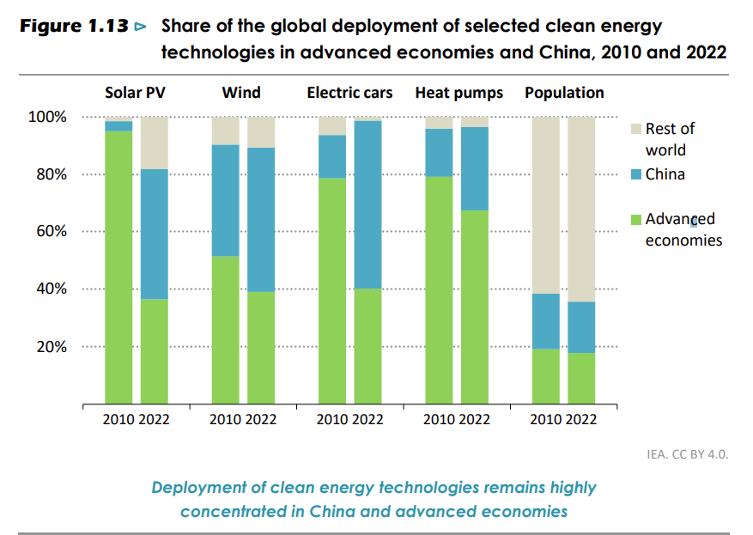
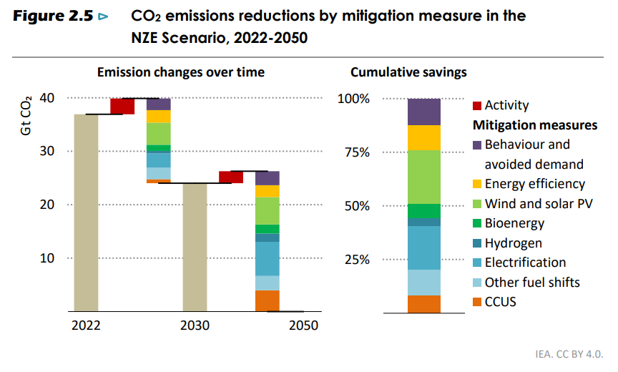
Global Efforts to Net Zero Emissions
Advanced economies must take the lead and reach net zero emissions by 2045 in aggregate in the NZE Scenario, China by 2050 and other emerging market and developing economies after 2050.
Mitigation Efforts Distribution to 2050:
  Solar Photovoltaics (PV) and Electrification: 50%
  Efficiency and behaviour change: 25%
  Other technology: 25%

Slide 9
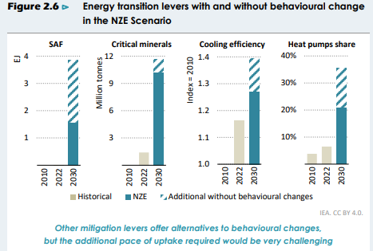
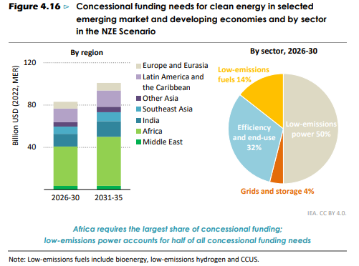
Transition Requirements
In the NZE Scenario, behavioural changes cut around 1 Gt CO2 from emissions-intensive assets which are still in use in 2030.
Clean energy investment needs to increase to around $4.5trn a year by the early 2030s, with a particular focus on developing countries.
Emerging technologies such as hydrogen and carbon capture, utilisation and storage (CCUS) cut emissions mainly after 2030.
Transmission and distribution grids expand by around 2 million km each year to 2030, and around 30 000 to 50 000 km of CO2 pipelines need to be installed.

Slide 10
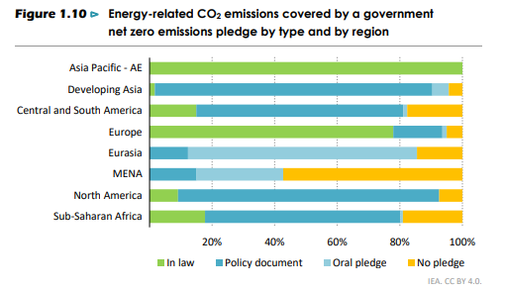
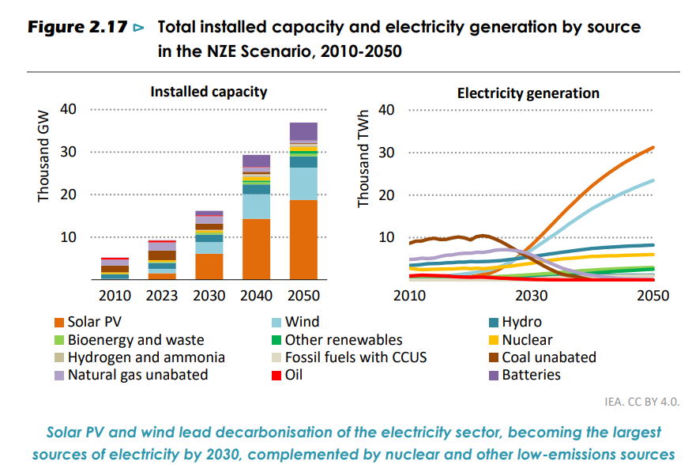
Key Uncertainties around IEA Roadmap
Optimistic techno-economic scenario, which highlights what could be done without political nuance.
  Not enough scenario building around policy actions.
Scenario fails to include LULUCF emissions from agricultural sector which are significant and difficult to abate.
  Main source of Methane emissions.
Roadmap relies on energy demand falling 10% compared to 2022, even as economies continue to grow.
  Reliance on behaviour change, which is difficult to predict/ control.

Slide 11
Fiscal Costs and Risks
From the Macro Fiscal Climate Reading Group

Slide 12
Executive Summary
‘UK Fiscal Risks Report 2021’

Slide 13
Transition Risks: Challenges Ahead
Mitigation efforts amplify the significance of transition risks.
Key uncertainties around transition:
  Scaling necessary infrastructure and accessing skilled workers.
  Lock-in effects of past choices.
  Delays in technology choice and investment.
  Role of public versus private sector.
Early mitigation actions may:
  Increase productivity.
  Expand a country’s global market share.
Delayed mitigation actions may:
  Avoid investment in unsuitable technologies.
  Allow countries to leverage the initial high costs borne by early actors.
  Lead to greater macroeconomic disruption.

Slide 14
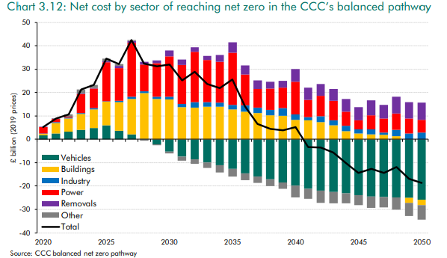
UK Case Study: Costs
Predicted Total Net Cost to Whole Economy (2020-2050): £321 billion.
  £1,312 billion investment costs offset by £991 billion net operating savings.
  By 2050, projected £19 billion annual saving vs. baseline emissions.
Key Costs Breakdown:
  Surface Transport:
    25% of total economy investment cost.
    Expected net savings from 2030 with increased investment.
  Buildings:
    28% of the whole economy total.
    Decarbonizing residential heating poses significant challenge.
  Power Generation:
    37% of the whole economy total.
    Key to achieving net zero as most sectors shift to zero carbon electricity.
  Industry:
    4% of the whole economy total.
  Removals:
    3% of the whole economy total
    Technologies for necessary scale not currently available.

Slide 15
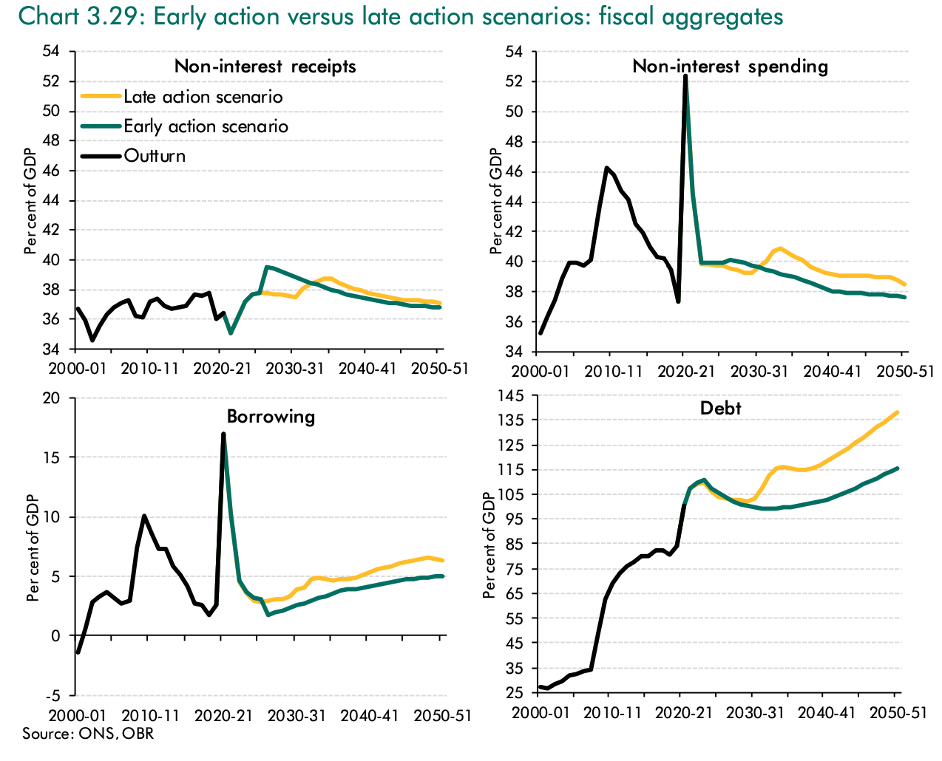
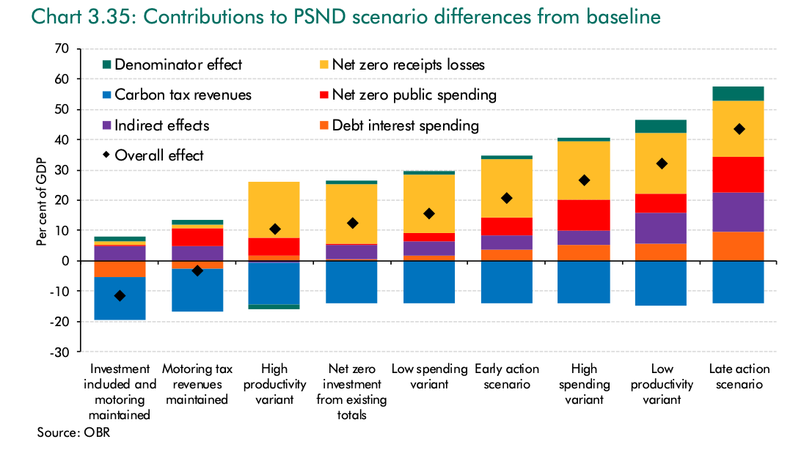
UK Case Study: Impact
Impact Areas:
  Direct Cost Burden on Government.
  Loss/Change of Tax Revenues.
  Indirect Effects on Public Finances.
Late versus Early Action:
  In the late action scenario, real GDP settles 3.2% below the early action scenario by 2050, with a peak loss of 6.6% in 2033-34. Debt-to-GDP ratio is initially lower but rises significantly from the 2030s onwards, reaching 23% higher by 2050-51 compared to the early action scenario.
% Borne by Public Sector:
  Uncertainty exists regarding the portion of transition costs borne by the public sector.
  PSND ranges from 5.9% of GDP above the early action scenario by 2050-51 in the high variant, and 5.2% of GDP below in the low.

Slide 16
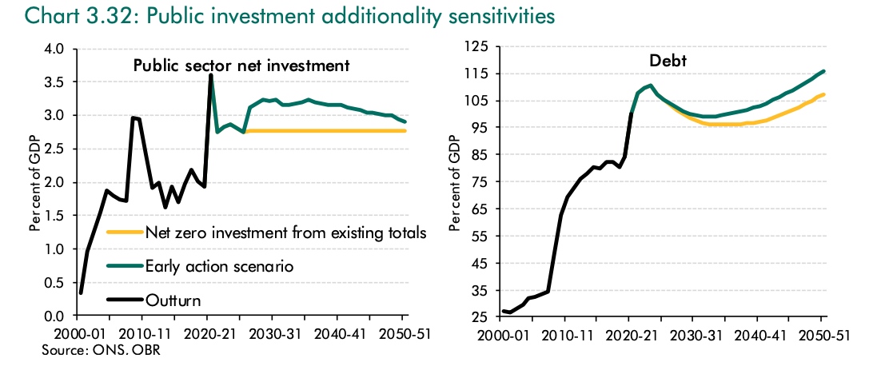
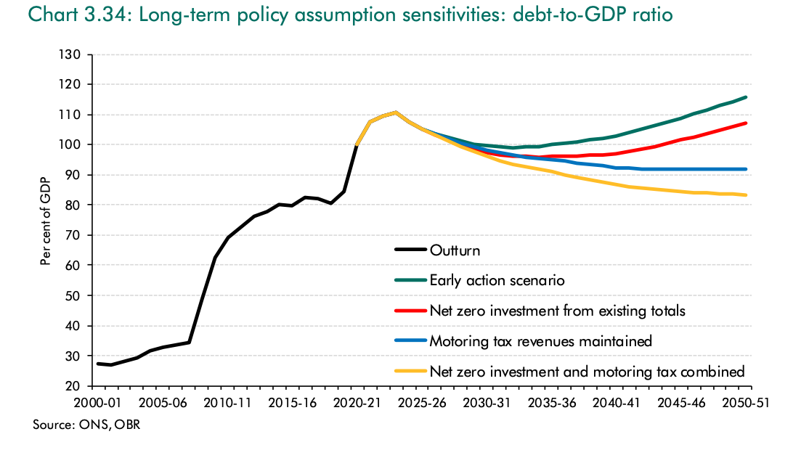
UK Case Study: Possible Fiscal Adjustments
Public Investment (If all net-zero investment is sourced from existing budgets):
  Public Sector Net Investment (PSNI) remains at 2.8% of GDP throughout.
  Public Sector Net Debt (PSND) projected to be 8.4% of GDP lower by 2050-51 compared to the early action scenario.
Taxes on Motoring (If lost tax receipts are replaced by equivalent levies):
  Receipts in 2050-51 would be 1.5% of GDP higher.
  PSND projected to be 24% of GDP lower than the early action scenario.
Implication:
  Demonstrates the potential of leveraging carbon tax revenues and existing public investment to mitigate fiscal consequences of early emissions reduction toward achieving the UK's net-zero emissions goal.

Slide 17
Key Uncertainties around Transition Risks
Considerable uncertainty remains around global temperatures, policy evolution, technology advancement, and infrastructure management.
It is important to stress that the quantification of fiscal risks in this case study is largely illustrative. Uncertainty is high!
Additional considerations:
  Potential for conflict or war.
  Existence of tipping points in the climate system.
  Public investment levels are estimated to be relatively low—could this reflect ideological preferences?
  Implicit assumption that transitioning to net zero emissions could negatively impact GDP—does this imply crowding out? What model underpins this assumption?
  Adopting a whole-economy perspective on interest rates rather than "passing the buck."

Slide 18
Economics of Adaptation
From the Macro Fiscal Climate Reading Group

Slide 19
Executive Summary
‘Shaping Climate Resilient Development’
The Economics of Climate Adaptation Working Group

Slide 20
Designing Adaptation Measures
“ Effective adaptation will involve decisions that are robust to a range of plausible climate futures and are flexible so they can be modified relatively easily. ”
3 key considerations:
  Present threats from today’s climate.
  Development paths that might put greater populations at risk.
  The largely uncertain additional risks from climate change.

Slide 21
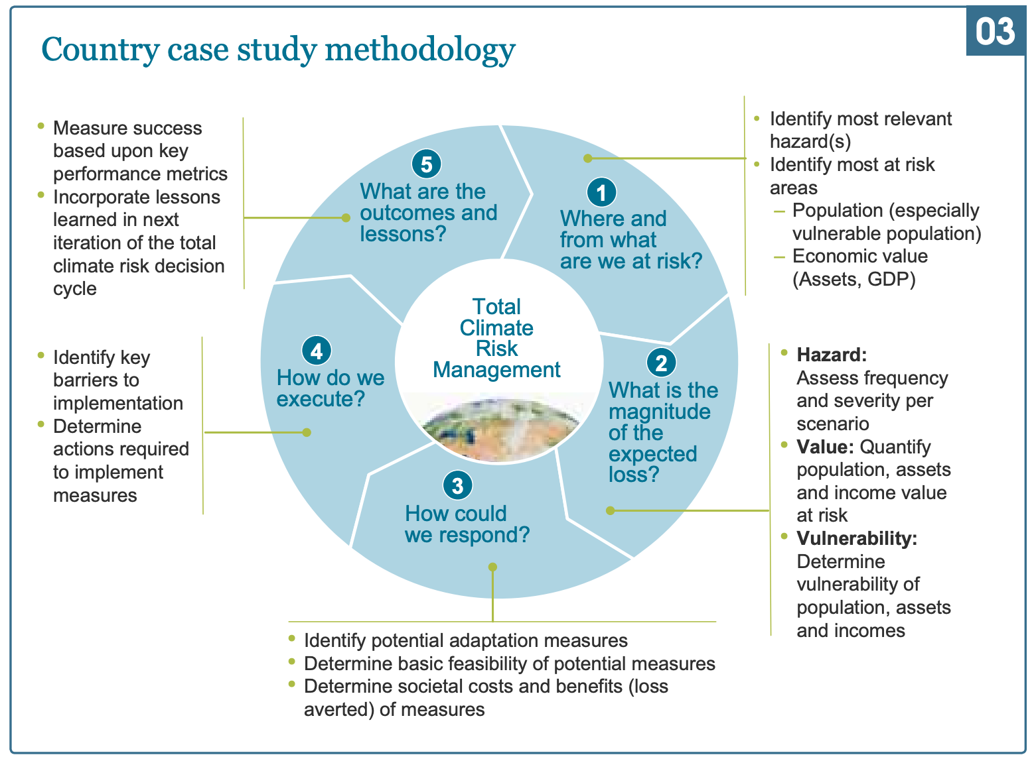
Approach to Assessing Total Climate Risk

Slide 22
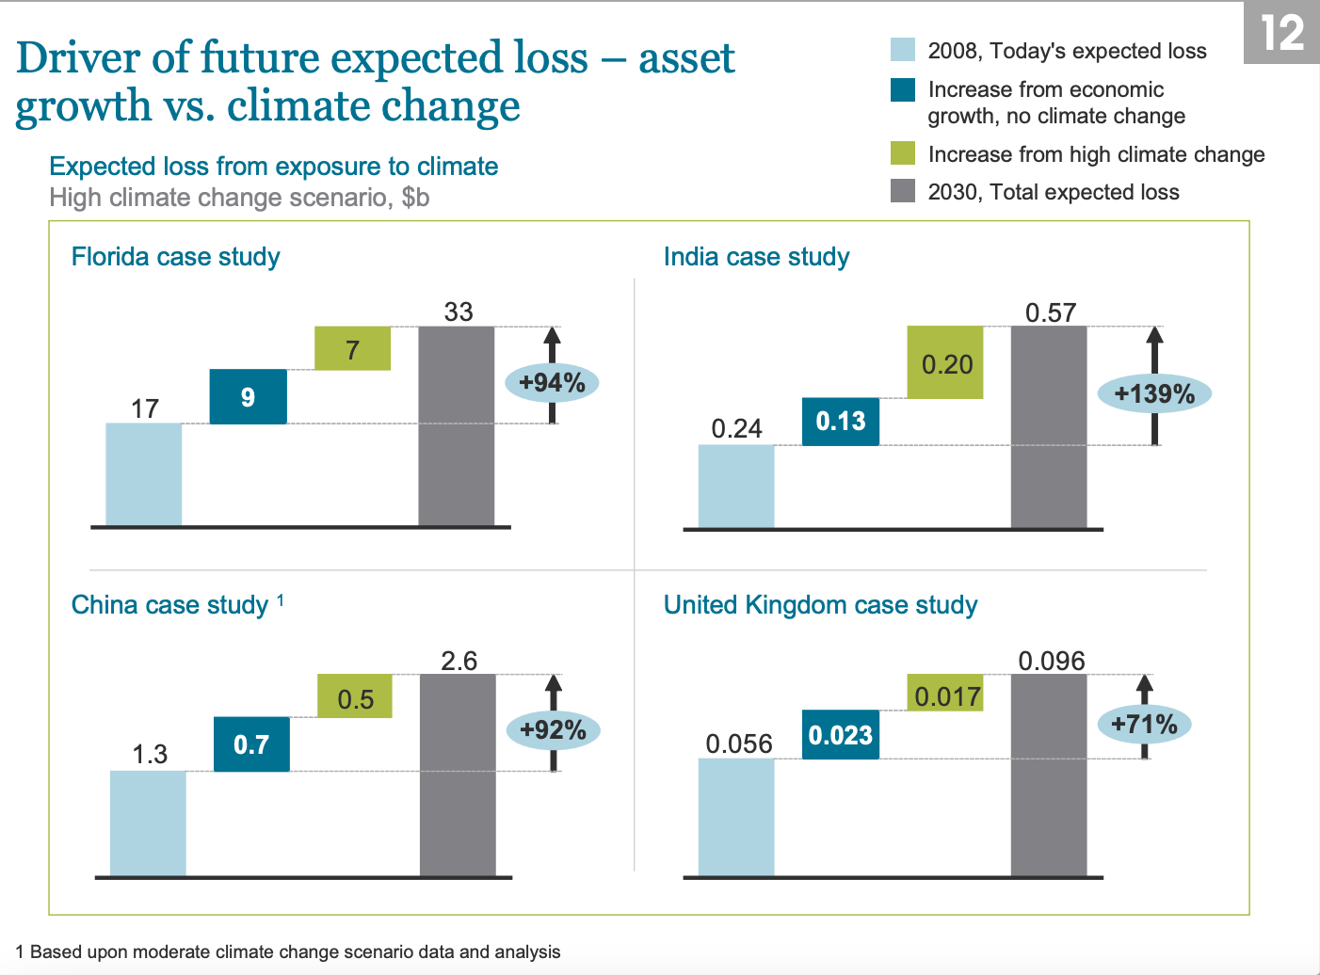
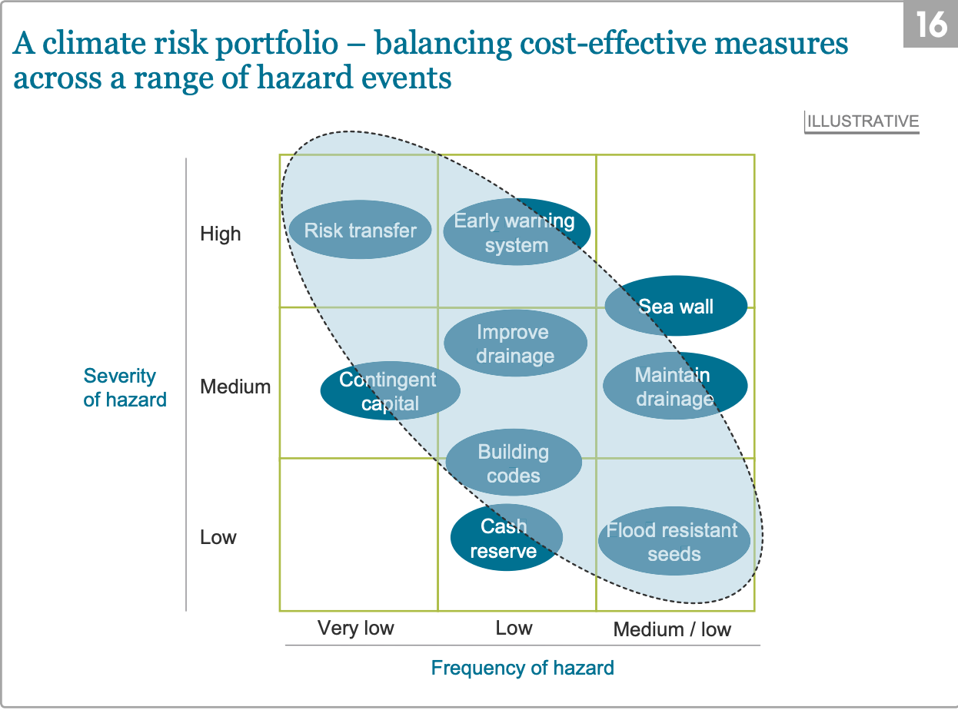
Methodology

Slide 23
Report Findings & Limitations
Findings:
Despite significant uncertainty, plausible scenarios can be constructed to base decision-making on.
Significant economic value is at risk (1-12% of GDP).
A portfolio of cost-effective measures can address a large part of the identified risk (40-68% can be averted through cost-efficient means).
Early and well-targeted adaptation measures are, in many cases, also effective in strengthening economic development.
Limitations:
Does not include the cost of environmental and social impacts from climate change.
Need to solve institutional and capacity issues

Slide 24
Is This a Useful Framework?
An old report, much has changed in the last 15 years.
Mainly covers micro-based interventions but potentially there are a lot of similar policies over different regions which may require macro policy or macro regional policy.
Report is still relevant and helpful:
  Creates a useful framework for thinking about adaptation and resilience.
  Scenarios have changed but so have adaptation measures.
Limitations:
  How do you adapt the analysis in climate disaster scenarios? If there are dramatic losses, how do you factor this in?
  Need a global cost curve including ecosystem damage and social costs.
  How do governments choose adaptation plans in a limited fiscal space, given all considerations?

Slide 25
Executive Summary
‘Adaptation Gap Report 2023: Adaptation Gap’
United Nations Environment Program

Slide 26
Executive Summary
‘Adaptation Gap Report 2023: Adaptation Gap’
United Nations Environment Program

Slide 27
https://www.unep.org/resources/adaptation-gap-report-2023

